Slide 1

COP 6731: Theory and Implementation of Database Systems
Normalization II

Slide 2
Outline
Goal:
Understand the concept of inferencing FDs
Key Concepts
Closure
Equivalent
Minimum Cover
3NF with Dependency Preservation and Non-addictive Join Property

Slide 3
Closure of a set of FDs (F⁺)
Given relation R and a set of functional dependencies F,
the closure of F (i.e., F⁺) is all dependencies that can be inferred from F.
F |= X → Y
Functional dependency X → Y is inferred from a set of functional dependencies F.
F⁺
F
Inference

Slide 4
Inference Rules for Functional Dependencies
Armstrong Axioms
1) Reflective Rule
If X ⊇ Y, then X → Y
2) Augmentation Rule
{X → Y} ⊨ XZ → YZ
Transitive Rule
{X → Y, Y → Z} ⊨ X → Z
Additional Rules
1) Decomposition Rule
{X → YZ} ⊨ X → Y, X → Z
2) Union Rule
{X → Y, X → Z} ⊨ X → YZ
Pseudo Transitive Rule
{X → Y, WY→Z} ⊨ WX → Z

Slide 5
Example
R = (A,B,C,D,E,H)
FDs:
A → C, AC → D, E → AD, E → H

Slide 6
Inference Rules for Functional Dependencies
Two set of function dependencies are equivalent if F⁺ = E⁺
R = (A, B, C, D, E, H)
FDs (F):
A → C, AC → D, E → AD, E → H
FDs (E):
A → CD, E → AH

Slide 7
Inference Rules for Functional Dependencies
A minimum cover (F_{min}) of set of FDs E
1) F⁺ is equal to G⁺
2) FD has a single attribute for its right-hand side.
(i.e., X → A where A is a single attribute.)
There is no X → A which can be replaced with Y → A where Y ⊆ X.
There is no redundancy.

Slide 8
Example
Minimum cover F_{min} of a set of FDs F
R (A, B, D)
F: {B → A, D → A, AB → D}
F_{min} : {B → D, D → A}

Slide 9
Example
Minimum cover F_{min} of a set of FDs F
R (A, B, C, D, E)
F: {A → BCDE, CD → E}
F_{min} : {A → BCD, CD → E}

Slide 10
Example 1
R (Emp_ssn, Esal, Ephone, Dno, Dname, Dlocation}
FD1: Emp_ssn → {Esal, Ephone, Dno, Dname, Dlocaton}
FD2: Dno → {Dname, Dlocation}

Slide 11
Example 1
R (Emp_ssn, Esal, Ephone, Dno, Dname, Dlocation}
FD1: Emp_ssn → {Esal, Ephone, Dno, Dname, Dlocaton}
FD2: Dno → {Dname, Dlocation}
Minimum Cover F_{min}
Emp_ssn → {Esal, EPhone, Dno}
Dno → {Dname, Dlocation}
R1 : {Emp_ssn, Esal, Phone, Dno}
R2 : {Dno, Dname, Dlocation}

Slide 12
Example 2
R (Emp_ssn, Pno, Esal, Ephone, Pname, Plocation, Dno}
FD1: Emp_ssn → {Esal, Ephone, Dno}
FD2: Pno → {Pname, Plocation}
FD3: {Emp_ssn, Pno} → {Esal, Ephone, Dno, Pname, Plocaton}

Slide 13
Example 2
R (Emp_ssn, Pno, Esal, Ephone, Pname, Plocation, Dno}
FD1: Emp_ssn → {Esal, Ephone, Dno}
FD2: Pno → {Pname, Plocation}
FD3: {Emp_ssn, Pno} → {Esal, Ephone, Dno, Pname, Plocaton}
Minimum Cover F_{min}
Emp_ssn → {Esal, Phone, Dno}
Pno → {Pname, Plocation}
R1 : {Emp_ssn, Esal, Phone, Dno}
R2 : {Pno, Pname, Plocation}

Slide 14
Example 2
R (Emp_ssn, Pno, Esal, Ephone, Pname, Plocation, Dno}
FD1: Emp_ssn → {Esal, Ephone, Dno}
FD2: Pno → {Pname, Plocation}
FD3: {Emp_ssn, Pno} → {Esal, Ephone, Dno, Pname, Plocaton}
Minimum Cover F_{min}
Emp_ssn → {Esal, Phone, Dno}
Pno → {Pname, Plocation}
R1 : {Emp_ssn, Esal, Phone, Dno}
R2 : {Pno, Pname, Plocation}
R3 : {Emp_ssn, Pno}

Slide 15
List all keys for R
Consider a relation R (A,B,C,D,E) and FDs: A → B, BC → E, and ED → A. List all keys (i.e., candidate keys) for R.
ACD, BCD, CDE

Slide 16
List all keys for R
Consider a relation R (A,B,C,D) and FDs: C → D, C → A, B → C. List all keys (i.e., candidate keys) for R.
B

Slide 17
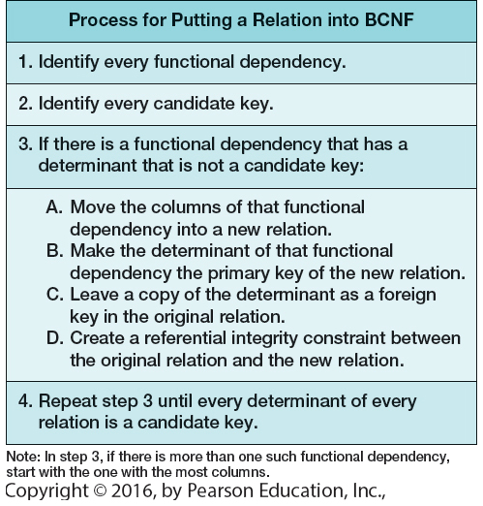

Slide 18
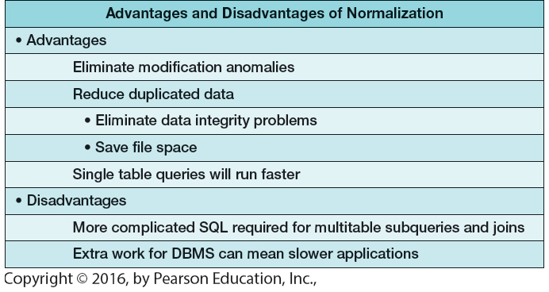

Slide 19
Take Home Message
Closure
Equivalent
Minimum Cover
3NF with Dependency Preservation and Non-addictive Join Property

Slide 20
Example (Minimum Cover) (Optional)
R (Property_id, County, Lot#, Area}
R (P, C, L, A}
FD1: P → CLA
FD2: CL → AP
FD3: A → C

Slide 21
Example (Minimum Cover) (Optional)
R (Property_id, County, Lot#, Area}
R (P, C, L, A}
FD1: P → CLA
FD2: CL → AP
FD3: A → C
Minimum Cover F_{min}
P → CL, CL → AP, A → C or P →LA, CL→ P, A →C

Slide 22
Example (Minimum Cover) (Optional)
R (Property_id, County, Lot#, Area}
R (P, C, L, A}
FD1: P → CLA
FD2: LC → AP
FD3: A → C
Minimum Cover F_{min}
P → CL, CL → AP, A → C or P →LA, CL→ P, A →C
R1 : PCL
R2 : CLAP
R3 : AC
R1 : PLA
R2 : CLP
R3 : AC

Slide 23
Example (Minimum Cover) (Optional)
R (Property_id, County, Lot#, Area}
R (P, C, L, A}
FD1: P → CLA
FD2: LC → AP
FD3: A → C
Minimum Cover F_{min}
P → LC, LC → AP, A → C or P →LA, LC→ P, A →C
R1 : PLA
R2 : CLP
R3 : AC
R1 : PCL
R2 : CLAP
R3 : AC

